Slide 1


Man in the contacts
and secure messengers: the ultimate spear-phishing weapon?
Laureline DAVID / Jérémy MATOS

Slide 2



Man in the contacts
Laureline DAVID / Jérémy MATOS
About the authors
Both based in French speaking Switzerland
Freelance consultant
HEIG-VD graduate in Security Engineering
https://ltouroumov.ch/
Laureline DAVID
Jérémy MATOS
Former developer of security solutions
OWASP Geneva co-chapter leader
Threat modeling aficionado
Appsec consultant at my own company: Securing Apps
https://www.securingapps.com/
@SecuringApps

Slide 3
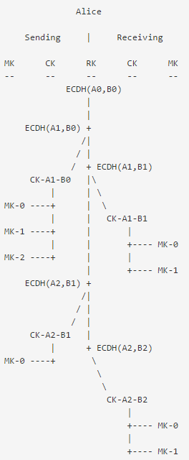
Man in the contacts
Laureline DAVID / Jérémy MATOS
Introduction
Popular messaging apps switched to end-to-end encryption
Great communication around it
Privacy is now a requirement
Debates at the government level to ask for backdoors: going dark ? Terrorists ?
Increased feeling that those applications are unbreakable
Super crypto. But wait …
Advanced ratcheting in Signal protocol: looks like an obvious flaw won’t be here ➔
But how messaging apps authenticate myself ?
  No explicit identifier
  Provisioning done by SMS
  Link to device/phone number
And my contacts ? Get them automatically from my address book

Slide 4





Man in the contacts
Laureline DAVID / Jérémy MATOS
Threat model: mobile app focus & simplified
SMS init code
SMS init code
Contacts
S
t
o
r
a
g
e
N
e
t
w
o
r
k
Messaging app
messages
messages
backups
E2E encryption
Other app
Mobile OS
Messaging
backend

Slide 5
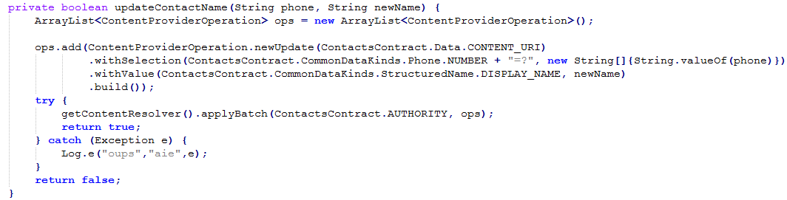
Man in the contacts
Laureline DAVID / Jérémy MATOS
Accessing contacts
Easy to read/modify/create contacts
There is an API for that
Android example ➔
Shared data structure accessible in read/write
Only restricted by permissions ➔
And it contains authentication data in clear
There is room for a side channel attack : Man in the contacts
Does not require a rooted device

Slide 6
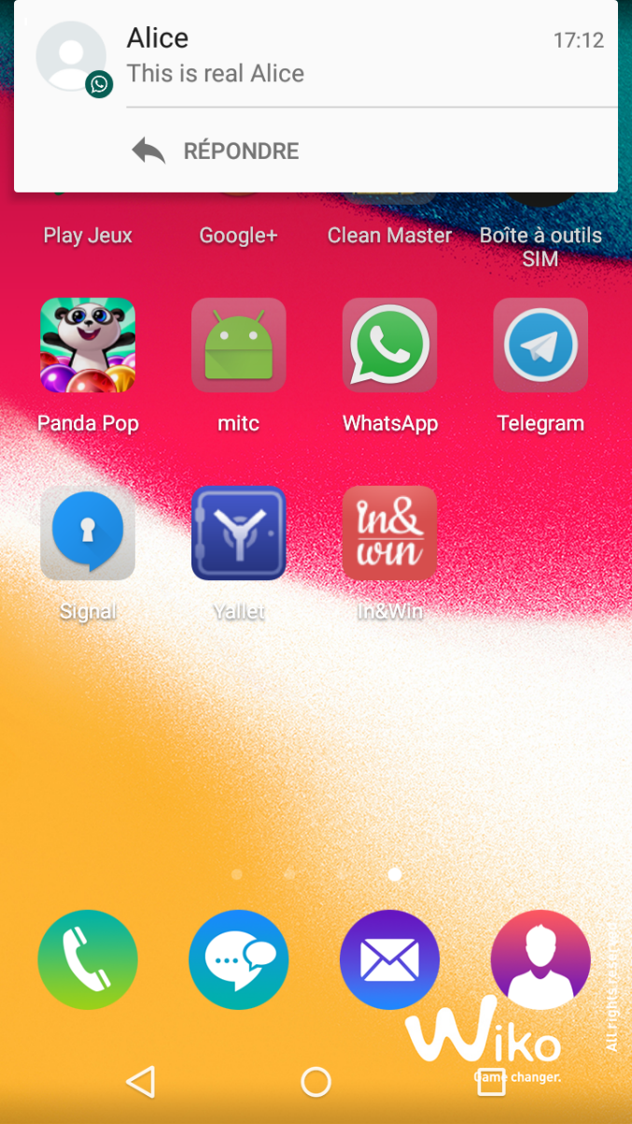

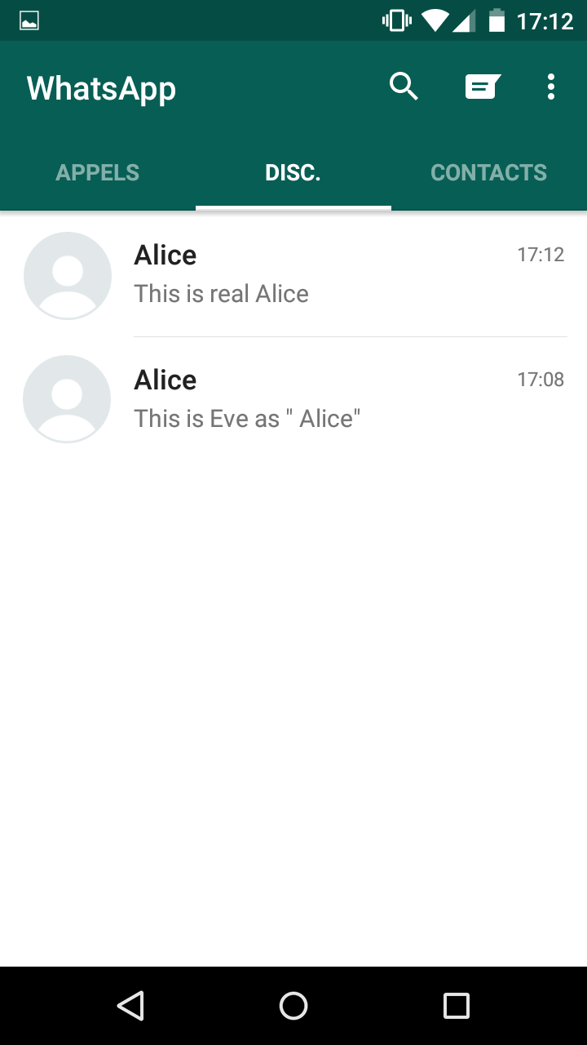
Man in the contacts
Laureline DAVID / Jérémy MATOS
Let’s create a new contact called “ Alice”

Slide 7
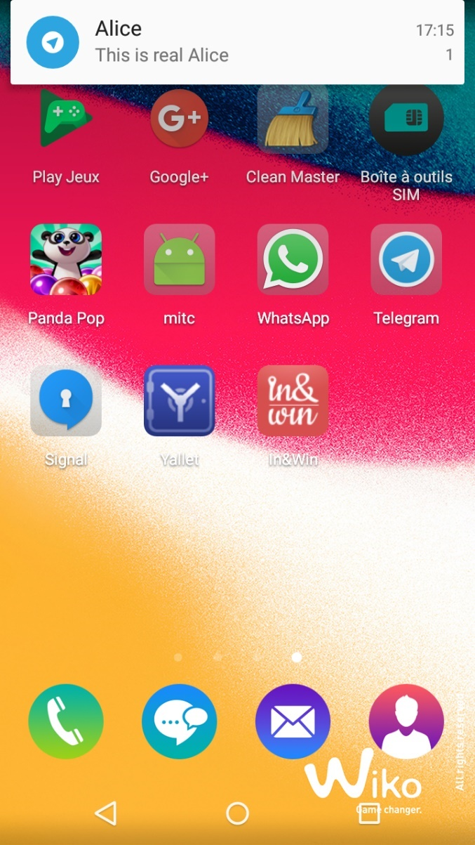
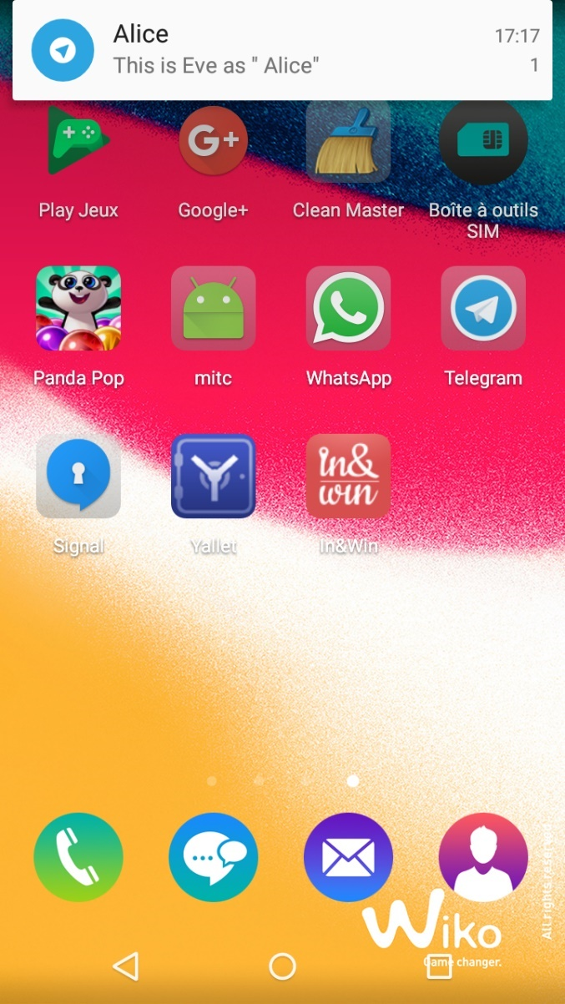
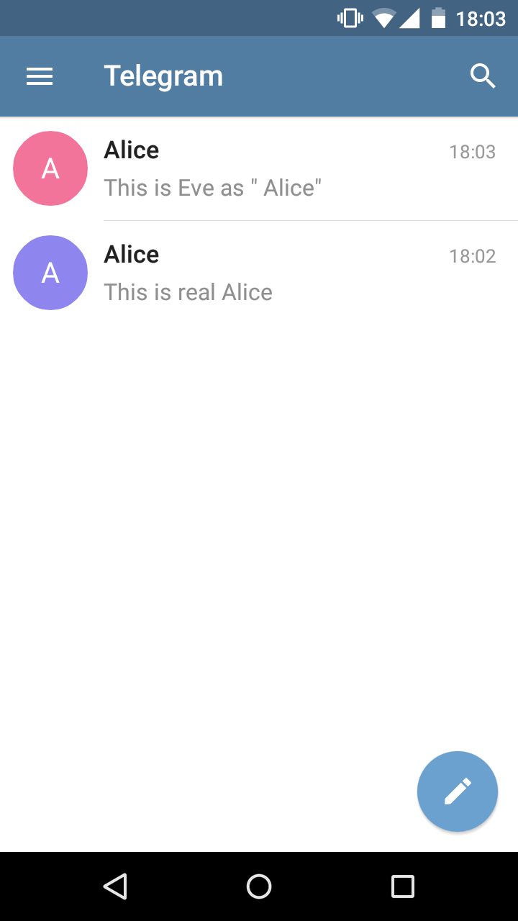
Man in the contacts
Laureline DAVID / Jérémy MATOS
Let’s create a new contact called “ Alice”

Slide 8


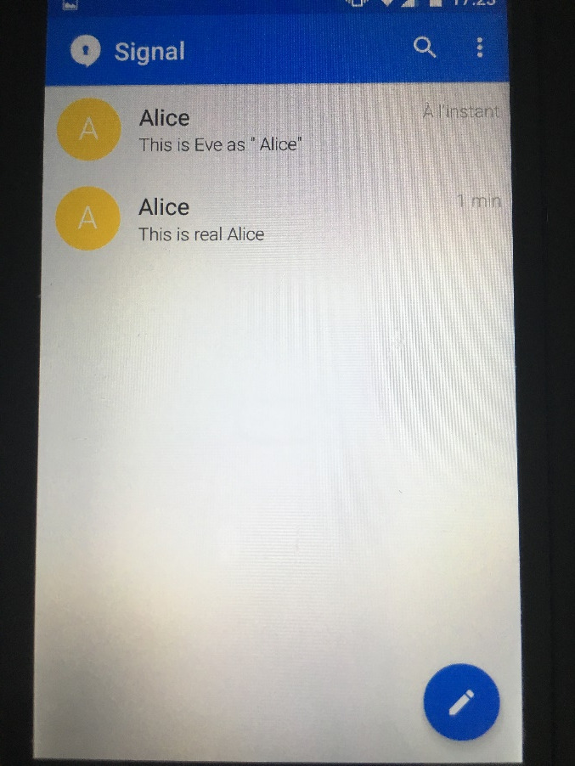
Man in the contacts
Laureline DAVID / Jérémy MATOS
Let’s create a new contact called “ Alice”

Slide 9
Man in the contacts
Laureline DAVID / Jérémy MATOS
Why does it work ?
Design error from a security point of view: phone number as implicit identifier is a poor choice
Abusing Trust On First Use (TOFU): new contact = new key = accepted by default
Same old trick of invisible characters
End user/mobile not really included in the threat model
  Focus on protecting network/backend (e.g. from government agencies)
  Side channel attack with some social engineering out of scope
  E.g. Formal security analysis of Signal protocol: https://eprint.iacr.org/2016/1013.pdf
  Signal specifies a mandatory method for participants to verify each other’s identity keys through an out-of-band channel, but most implementations do not require such verification to take place before messaging can occur
Bonus: messengers store their own identifiers in the contacts
➔ we can know from another application if WhatsApp, Telegram or Signal is installed despite sandboxing

Slide 10
Man in the contacts
Laureline DAVID / Jérémy MATOS
Attack scenario 1: Man in the Middle
Convince Alice and Bob to download a social game from the official PlayStore requiring contact permissions
When Alice and Bob start the game, a remote server controlled by Eve is notified that they have a secure messenger installed and now listens for contact orders
Eve asks remote server to create “ Alice” in Bob’s phone and “ Bob” in Alice’s phone
Eve sends as “ Alice” via secure messenger an introduction message to Bob.
Bob is thinking he is talking to real Alice.
Eve forwards as “ Bob” the answer of Bob to Alice.
Alice is convinced it is the real Bob because it’s really his words.
Alice answers to ” Bob”, who is in fact Eve. Eve can now forward the message to Bob as “ Alice”.
Bob is also convinced. ➔ We now have a full Man in the Middle
Alice and Bob are using E2E encrypted communications but they are talking to the wrong contact without noticing

Slide 11
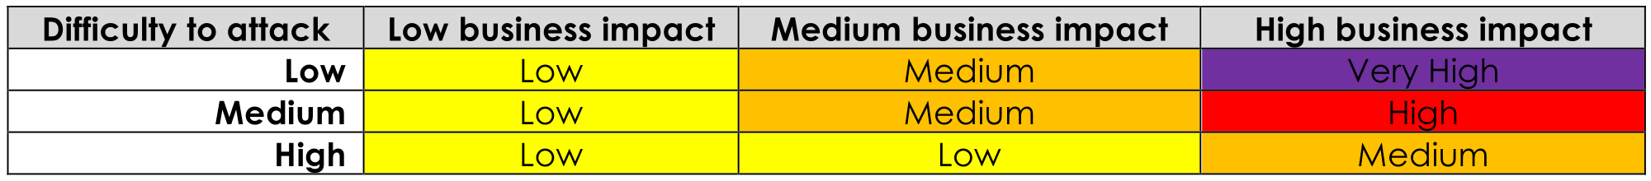
Man in the contacts
Laureline DAVID / Jérémy MATOS
Risk assessment
Simple evaluation: risk = easiness of attack * user impact
Difficulty of attack: Low to Medium
  Technical: Low
    Easy to access contacts via code
    Not a problem to get MITC application approved for publication
  Logistics: Medium
    One phone number is enough
    But need to convince many users to install the application
User impact: High
  Thousands of users can be spied via those 3 famous messengers

Slide 12
Man in the contacts
Laureline DAVID / Jérémy MATOS
Vendors feedback
Telegram
security@telegram.org = /dev/null
WhatsApp (Facebook)
We appreciate your report. Ultimately an attacker with malware installed on a device is going to be able to alter data on the device itself. In your examples for WhatsApp conversations remained properly bound to the phone number that the messages were sent to. Beyond that, WhatsApp allows people to set local aliases for contacts and to view the number associated with a specific message thread at any point. Given that, we don't feel that this behavior poses a significant risk and we do not plan to make any changes here. Please let us know if you feel we've misunderstood something here!
Signal (Moxie Marlinspike)
Hey Jeremy, saw your support email about "man in the contacts." This, like all interception techniques, is what safety numbers are for. Signal users would be notified that the safety numbers for their contact have changed, and be asked to verify them. A successful MITM attack would need to find a way to intercept communication without triggering that notice.
-------------
Hey Jeremy, Signal is not designed to protect your device against malware. Thanks for getting in touch, good luck with everything.

Slide 13
Man in the contacts
Laureline DAVID / Jérémy MATOS
Implementing Man in the contacts in practice
Bachelor thesis of Laureline
1. Android game: a social version of Rock, Paper, Scissors
Available on Google PlayStore at https://play.google.com/store/apps/details?id=com.tricktrap.rps
Approved without any issue on July 2017
Biggest challenge: contact API is a total mess
2. The Command-and-Control server
Python based
Overview of its web interface

Slide 14
Man in the contacts
Laureline DAVID / Jérémy MATOS
Attack scenario 2: Spear-phishing
Convince Alice to download the social game
When Alice starts game, a remote server controlled by Eve is notified that a secure messenger is installed and now listens for contact orders.
Eve asks remote server to create “ Bob” in Alice’s phone.
Eve send a malicious link to Alice as “ Bob” via secure messenger.
Alice clicks on it because she knows well Bob and it is a super secure messenger.
Backend servers cannot filter dangerous content because by design they can’t read the messages.
NB: Desktop versions of those secure messengers are more and more popular
Live demonstration
Any volunteer ?

Slide 15
Man in the contacts
Laureline DAVID / Jérémy MATOS
Open sourcing the tool
Source code of Android game available at https://github.com/ltouroumov/rockpaperspam-client
Source code of Command-and-Control server is available at https://github.com/ltouroumov/rockpaperspam-server
Don’t hesitate to share those links
Vendors may now better understand that it can be a real-life issue.

Slide 16
Man in the contacts
Laureline DAVID / Jérémy MATOS
Possible mitigations
End users
Avoid installing applications requesting contact permissions.
But this is the case for secure messengers ….
Mobile OS
Sandbox contact information
Be stricter on write operations to address book
Secure messengers
Give up implicit trust on contact information:
require users to manually add people they are talking to
Or raise user awareness when a conversation is starting with a brand new contact:
make it clear in U.I. this an unusual situation, e.g. with a danger sign

Slide 17
Man in the contacts
Laureline DAVID / Jérémy MATOS
Conclusion
E2E encryption cannot guarantee privacy if you’re not sure who you are talking to
Beware of messages showing good cryptography is used because it can bring a false sense of security
Security model around contacts if far too open for sensitive apps
If the design of your solution includes access to contacts, start with a threat modeling session
Tool open sourced to demonstrate secure messengers should not be trusted blindly
Their great security reputation can be used against them for a successful social engineering attack
By design dangerous messages cannot be filtered

