Slide 1
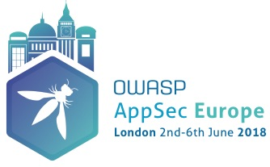

Building Valid Threat Libraries for Cloud Based Applications
Substantiating Threat Models w/ Threat Data
Tony UcedaVelez // @t0nyuv

Slide 2

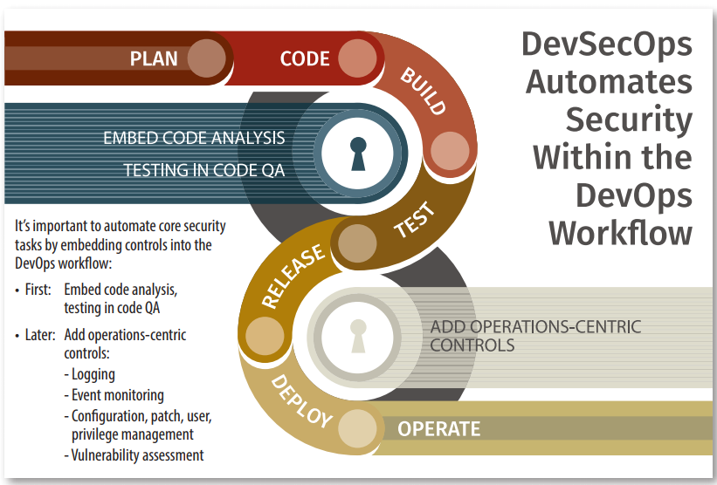
Talk Objectives
Author name her
Tony UcedaVelez // @t0nyuv
Leverage a Threat Model to guide DevSecOps
Threat Modeling activities lend well to DevSecOps stages
  Threat Library builds context of applicable menaces to Cloud application based upon industry, data model, and technology footprint. Blueprints attack patterns to test, vulns to check, controls to configure
Correlating Threat Libraries to build security controls in DevOps is possible.
  Threats → Attacks → Vulns → Affected Components → Controls for Automation
Fosters security automation in Building, Test, Release, Deploy, & Operate phases.
  Threat Modeling (PASTA S1-S4) → Plan stage
  Risk based Countermeasure Development (PASTA S7) → Code, Build, Deploy
  Vulnerability Analysis (PASTA S5 → Deploy (Configuration), Operate
  Threat Analysis (PASTA S4 → Operate (Monitoring), Plan)
Source: metalop.com

Slide 3






Speaker Background
Author name her
Tony UcedaVelez // @t0nyuv
Bio & Background
CEO/ Founder, VerSprite (www.versprite.com) – Global Security Firm
OWASP Atlanta Chapter Leader (past 10 years)
Author, “Risk Centric Threat Modeling – Process for Attack Simulation & Threat Analysis”, Wiley June 2015
Passionate global, threat modeling evangelist
~25 years of diverse IT/ Security experience in software development, architecture, pen testing, threat modeling, sys admin, security operations
Dreams of bankrupting #infosec with intelligent, threat inspired DevSecOps automation
@t0nyuv
www.linkedin.com/tonyuv
tonyuv@versprite.com
https://versprite.com/security-resources/blog/

Slide 4
Threat Considerations & Misinterpretations
Basic Tenants of Threat Libraries in Cloud Threat Models
“Cloud security automation can leverage threat models as blueprints; threat libraries that leverage both threat intel & data help kickoff evidence based DevSecOps security workflows”

Slide 5
Problem & Resolutions on Today’s Threat Models
Cloud, Threat Confusion, Misuse Impairs Ability to Model Threats
Tony UcedaVelez // @t0nyuv
Problem Statement: Threat Models are Not Addressing Cloud Related Threats
Many threat modeling activities are foregoing the inclusion of threat considerations.
Vulnerabilities ≠ Threats; DFDs ≠ Threat Models
Since vulnerabilities do map to exploits, many equate exploits or attack patterns to threats
Practitioners compelled to only look outwardly to threat intel vs. leveraging threat data
AWS & Azure both provide centralized ‘dashboard’ of security threats, however, still overwhelming to look at.
  Azure Security Center (now Hybrid) facilitates alerts per tenant.
    Means Energy, Transportation sectors dependent on SaaS vendors for efforts between threat identification to mitigation.
Proposed Resolution: Help Substantiate your Threat Model w/ Threat Data & Customer Threat Intelligence
Important to substantiate your threats for your Cloud threat models
Threat intelligence provides outside, industry threat perspectives
However threat data provides security events/ incidents that may support threat claims in a threat model
  Threat data can substantiate underlying attack patterns in a threat model
SME/Security Champion conducting threat modeling can leverage threat intel and data
Notes:
Vulnerabilities ≠ Threats: many relate the presence of CVEs or CWEs as imminent threats with unqualified certainties to occur. This is unscientific.
Data flows alone will not substantiate threat claims. DFDs do not complete a threat model by themselves. Understanding flows is critical to understand how and where data flows
Threat data vs threat intel. Substantiate your threat models with both threat intel and threat data. Know the difference which is that threat data are true positive security incidents/ events that can compliment your threat intel.

Slide 6


Clarifying Threat Terms Use & Abuses
Threats Against Cloud Castles – Key Threat Modeling Points to Consider
Tony UcedaVelez // @t0nyuv
Threat modeling should represent “Model of Threats”
  Threat model can serve as blueprint for DevSecOps efforts across the FULL Cloud stack.
Remember Cloud can be SaaS, PaaS, IaaS, CaaS; Cloud is not just serverless apps, containers, or VMs.
Today, threats are often inferred from Attack Surfaces or Vulnerabilities.
Threats should point to viable attack patterns that can automated via automated testing.
  Example: Crypto mining threat (aka cryptojacking) via priv escalation attack to instantiate new EC2 instance
“Threat Hunting” has completely perversed the use of threat intelligence.
  Reboot & refactor needed to iteratively feed threat models.
Threat data may represent lessons learned from prior battles/ attacks logged in Cloud management logs, VMs, serverless apps
Notes:
Blueprint for planning, designing, building, deploying, testing, releasing and operating at the full stack
Very limited good threat intel out there. Best to build your own. Today’s threat intel focused on Energy sector took about 2.5 hours to research. Sources include CERTS, *-ISACS, RSS Feeds into workflows (e.g – Slack, Teams, etc.), Twitter scrapers, etc.
Threat data provides great way to substantiate or evolve your threat model and library by feeding it new instances of probes, queries, or attacks captured in security events and incidents.

Slide 7
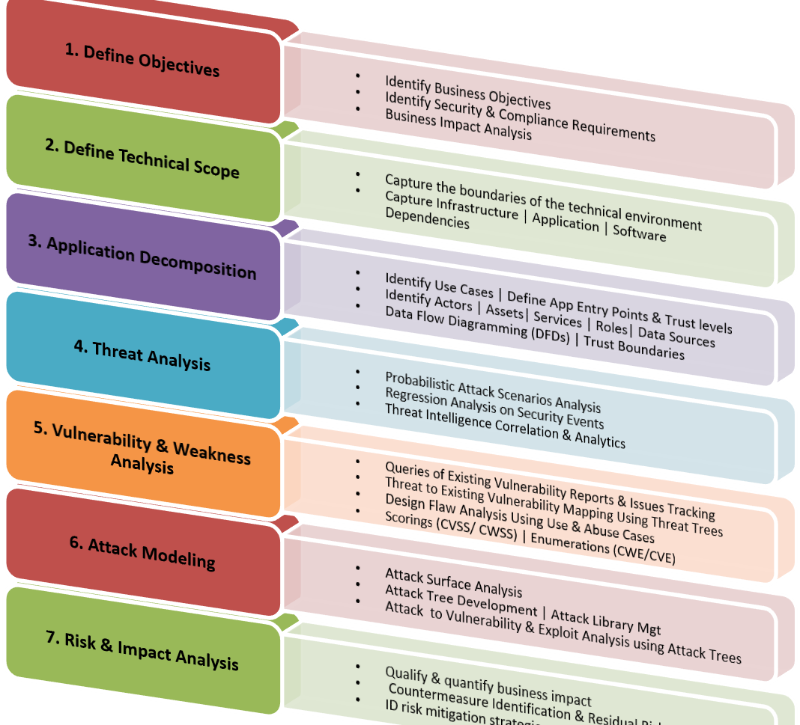
PASTA Methodology applied to Cloud
PASTA applies to the full stack, not just the App tier
Stage I sets tone of importance around Cloud use cases, particularly in Energy sector where use cases can be baselined in Cloud Apps/ Management APIs
Stage II defines technical scope of app components; essentially can provide attack surface across full stack in CSP.
Stage III maps use cases to actors/ worker processes and data sources in Cloud. Helps in IAM Cloud policy configuration via Cloud Mgt APIs.
Stage IV correlates relevant threat patterns. Threat intelligence and threat data fed. (Key focus of talk).
Stage V & VI – “proof” stages; prove viability; allow for integrated security testing in threat-led DevSecOps efforts
Stage VII – Rationale for countermeasure development based upon residual risk can be incorporated into Design & Build phases of DevSecOps lifecycle.
Model is fed by Operate & Monitor phases in DevSecOps
Notes:
Stage IV allows for DevSecOps operations to scan for CVEs, CWEs specific to attack surface in Cloud stack
Stage IV also allows to test for misconfigurations in architectural network design via Cloud mgt API checks

Slide 8
Tiered Approach to PASTA DevSecOps Adoption
Scoping Cloud API PUTS & GETS Supports Evidence Driven Model
Tony UcedaVelez // @t0nyuv
Blind Threat Model
Evidence Driven Threat Model
Full Risk Based Threat Model
Industry ‘Best Practice’ Applied to app components
Maps key goals of app or service and correlates to clear technical standards for architecture, hardening of server/ service, app framework, containers
Applies Stage 1 & Stage 2 of PASTA
Integrate threat log data analysis
Focus on logs that support attack vector w/ greatest motives (e.g. – TLS MITM vs. Injection based events)
Correlate threat evidence for substantiating threat trends of attacks for target apps.
Ability to run statistical analysis/ probabilistic analysis on threat data & attack effectiveness
Consider non-traditional attack vectors, still supporting threat motives.
Conduct probabilistic analysis on threat data and attack sequences from pen testing efforts.
Notes:
Vulnerabilities ≠ Threats: many relate the presence of CVEs or CWEs as imminent threats with unqualified certainties to occur. This is unscientific.
Data flows alone will not substantiate threat claims. DFDs do not complete a threat model by themselves. Understanding flows is critical to understand how and where data flows
Threat data vs threat intel. Substantiate your threat models with both threat intel and threat data. Know the difference which is that threat data are true positive security incidents/ events that can compliment your threat intel.

Slide 9
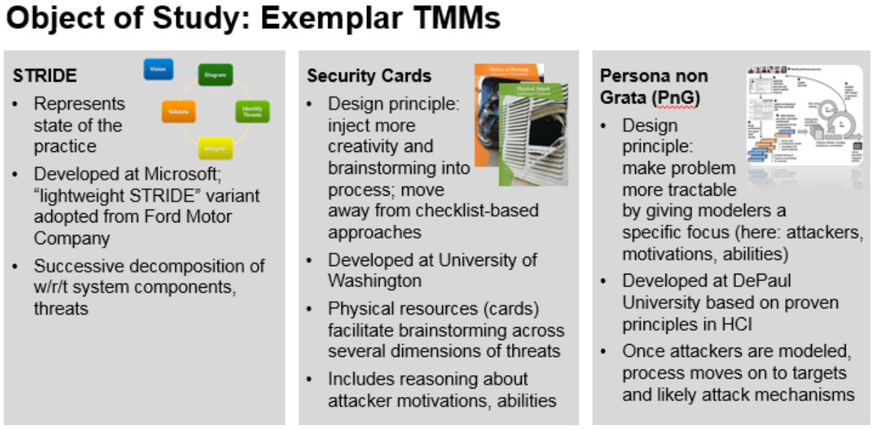
Collaboration in DevSecOps
Carnegie Mellon TMM November 2016 Study
Tony UcedaVelez // @t0nyuv
PnG reflected least false positives
PnG reflected consistent threats across multiple teams conducting threat analysis
PASTA focuses on:
  Substantiating models with real threats
  Supporting threats via real attack patterns that can be tested (DevSecOps test cases)
  Supporting vulns that map to attack patterns (e.g. – CWE/ CVE: CAPEC mapping)
  Collaborative amongst various constituents
“Developed at DePaul University, the Persona non Grata approach makes threat modeling more tractable by asking users to focus on attackers, their motivations, and abilities. Once this step is completed, users are asked to brainstorm about targets and likely attack mechanisms that the attackers would deploy.”
Source: https://insights.sei.cmu.edu/sei_blog/2016/11/cyber-threat-modeling-an-evaluation-of-three-methods.html

Slide 10
Objectives in Building a Threat Library
Tony UcedaVelez // @t0nyuv
Learn to Substantiate Your Model
Research
FUD perceptions do not constitute valid threat patterns
Threats help contextualize probability of threat occurrence for assets at risk
Provides realistic considerations to real threats affecting critical infrastructure (i.e. – Transportation/ Energy)
Threat patterns provide a top level hierarchy context to organize underlying attacks, vulnerabilities around crucial infrastructure being threat modeled.
Threat Data
Threat Intelligence
Industry Reports/ Trends
Analyze
Select most relevant threats
Consider timing of threat info
Remember that attack patterns ≠ threats
Role of the Threat Library
Incorporate
Provides ‘living’ body of content around viable threats
Should be revisited monthly to see if an evolving threat landscape warrants changes to the threat library
Provides a list of threats that shape the pinnacle node of attack trees.
An exhaustive list is not the objective; a quality list is.
Prioritized top threats based upon assumed impact
Threats serve as top nodes in attack tree

Slide 11
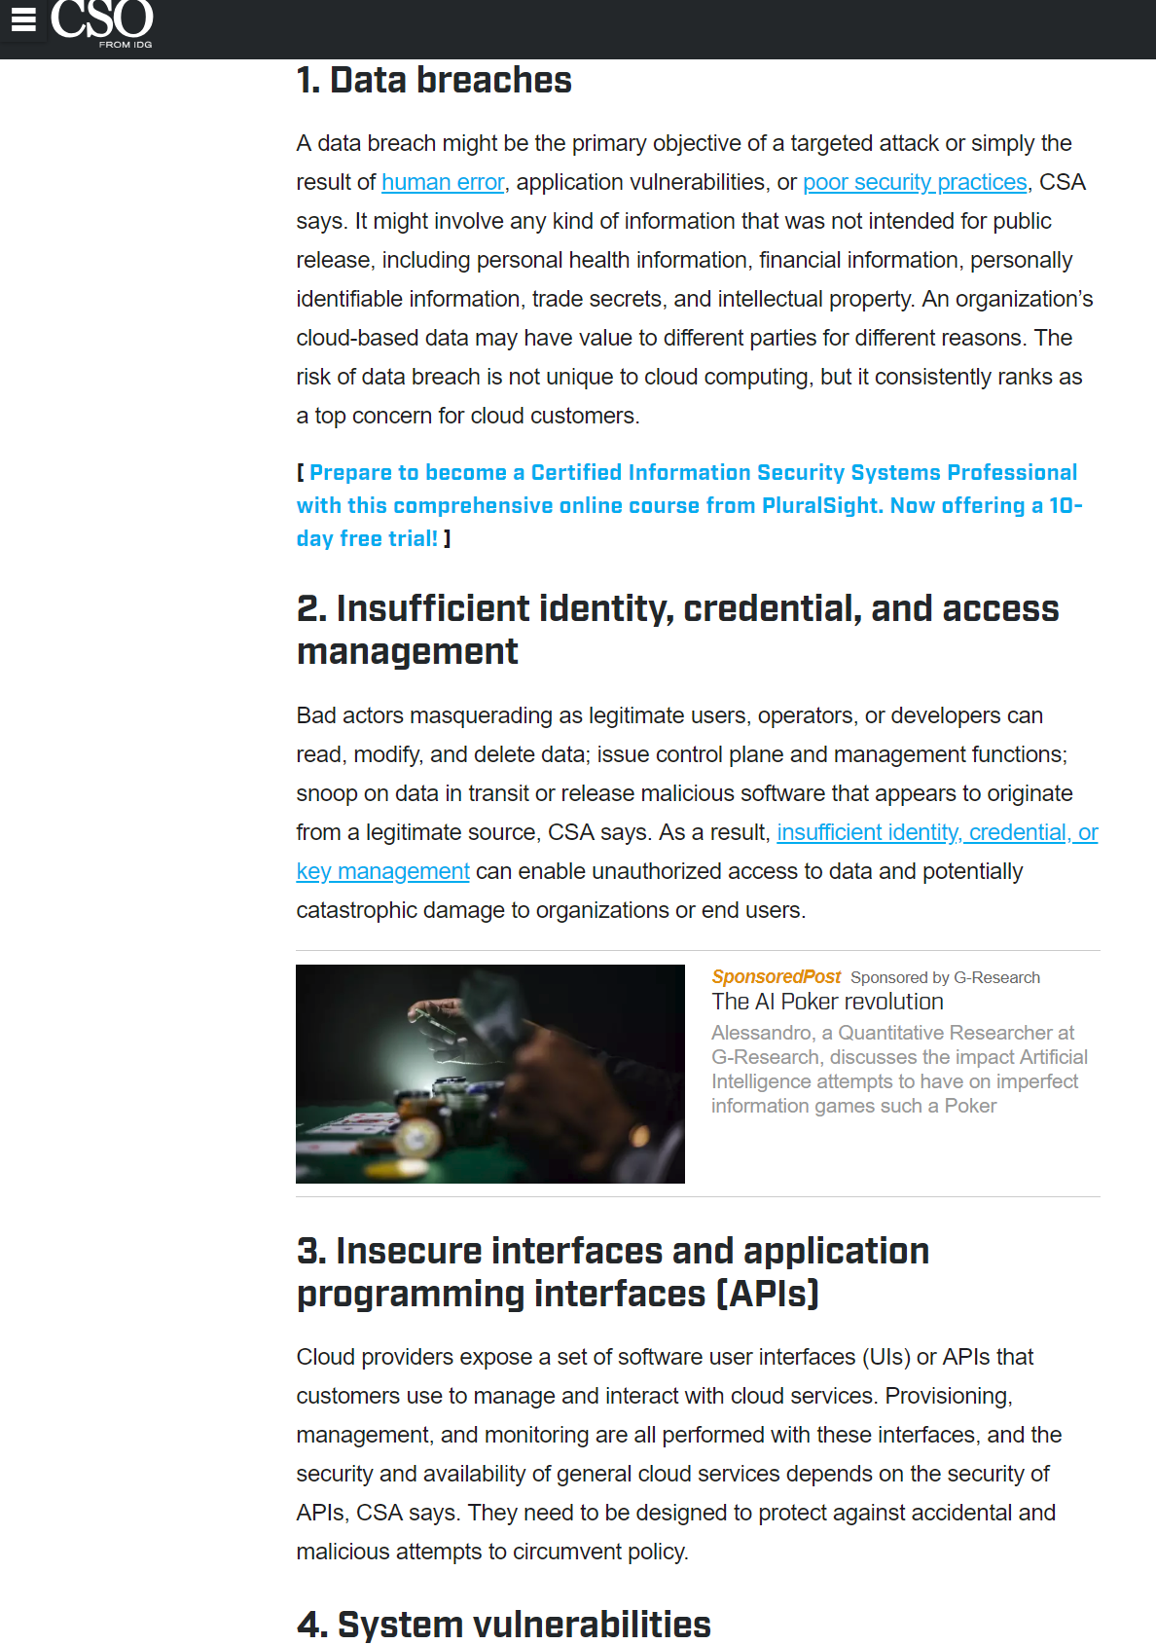
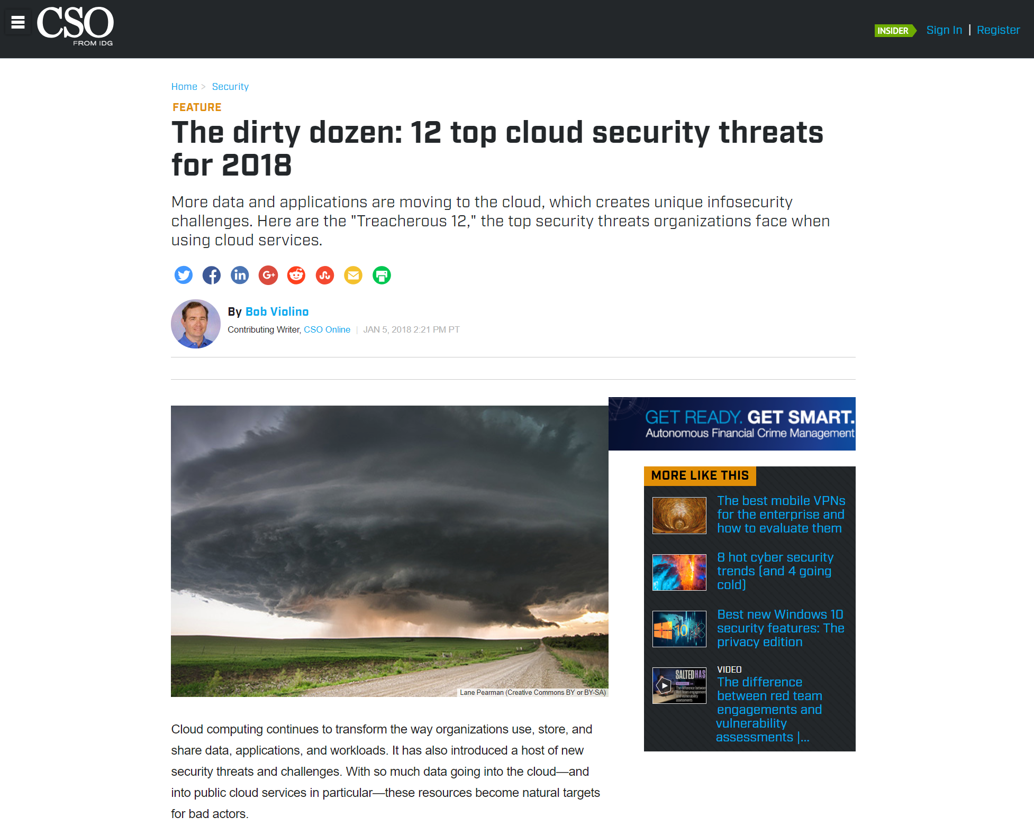
Break Bad Threat Consumption Habits
Importance of Consistency in Good Threat Information
Author name her
Tony UcedaVelez // @t0nyuv
Security Media Can Have Worst Threat Info
Vulnerability reports masquerading as threat information
Function + Dysfunction Threat Mashup
Collaboration between those that understand functional use + creative, threat driven approaches can easily kickstart a great threat library.
For Critical Instructure government resources provide good insight to the function of key industries and associated systems
  [ENERGY] European Commission (EC), Energy Expert Cyber Security Platform (EECSP) Expert Group
  [TRANSPORTATION] PT-ISAC (U.S) Public Transportation Info Sharing & Analysis Center
    Transit And Rail Intelligence Awareness Daily (TRIAD) replaced daily PT-ISAC report
Industry Incidents to Threat Considerations
Reported incidents against CI best form of auto-checking or adding to threat libraries

Slide 12
Threat Modeling + DevOps in Energy Sector
Opportunities for Security Automation via Evidence Supported Threat Modeling
A brief case study on Cloud adoption in Oil & Gas and how an evidence supported library can be the cornerstone to a good threat model and foster security automation.

Slide 13

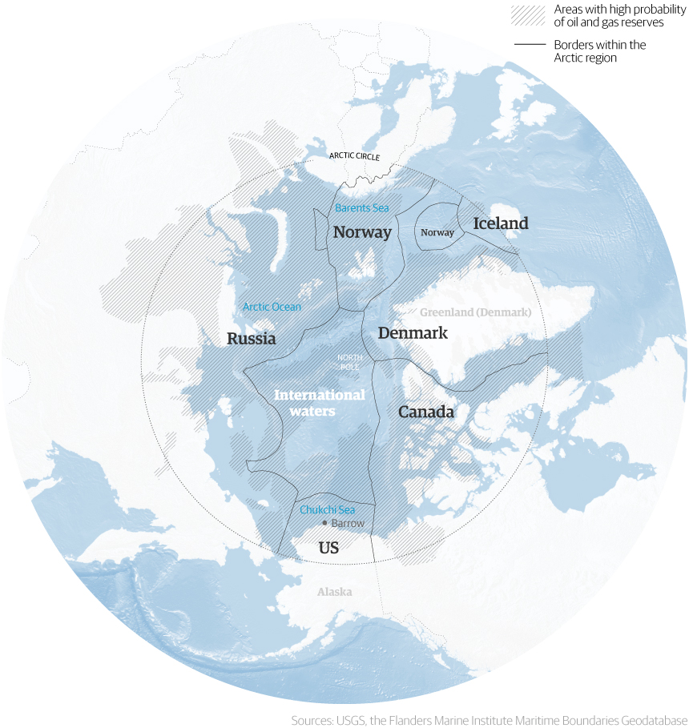
Building a Threat Library for Oil & Gas
DevSecOps Threat Tuning Begins w/ a Solid Threat Library
Building a Threat Library for Gas & Oil Players
Traditional threats to Oil & Gas are physical in nature
  piracy
  terrorism
  insurgency
  organized crime
  civil protest
  inter-state hostilities
  vandalism
  internal sabotage
Highly competitive, capital intense industry, depending on accuracy field data shapes future use of Cloud adoption
Cyber related threats aim to incapacitate interconnected systems.
  Taint Data [Integrity, Availability] Research Exploration, Operations Data
  Extortion via suppressing [Availability] of Cloud management panels or Cloud Energy SaaS Apps
  Mine Cryptocurrency on PaaS infrastructure [Integrity]
  Steal Secrets (e.g. - Exploration/ R&D) [Confidentiality]
Notes:
Oil and Gas/ Energy sector is Critical Infrastructure
Energy sector slowly adopting Cloud solutions for various facets of Exploration, Well Operations, R&D, Pipeline buildouts, etc.
Mining of data is all about greater efficiency in Oil & Gas operations
Data Integrity & Availity is king for Suppliers
Availity & Confidentiality is king for Distributors
Threat libraries do not have to be exhaustive

Slide 14
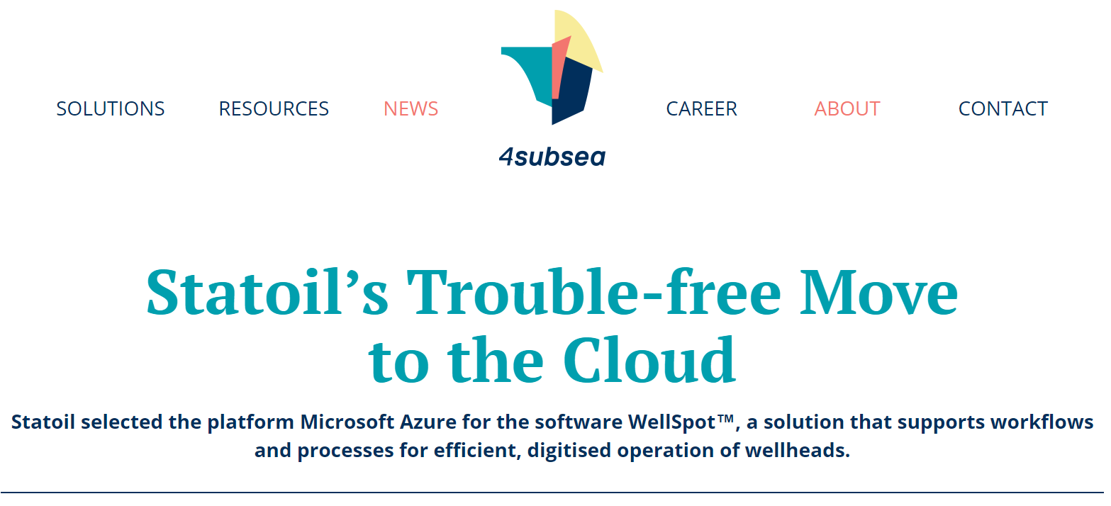
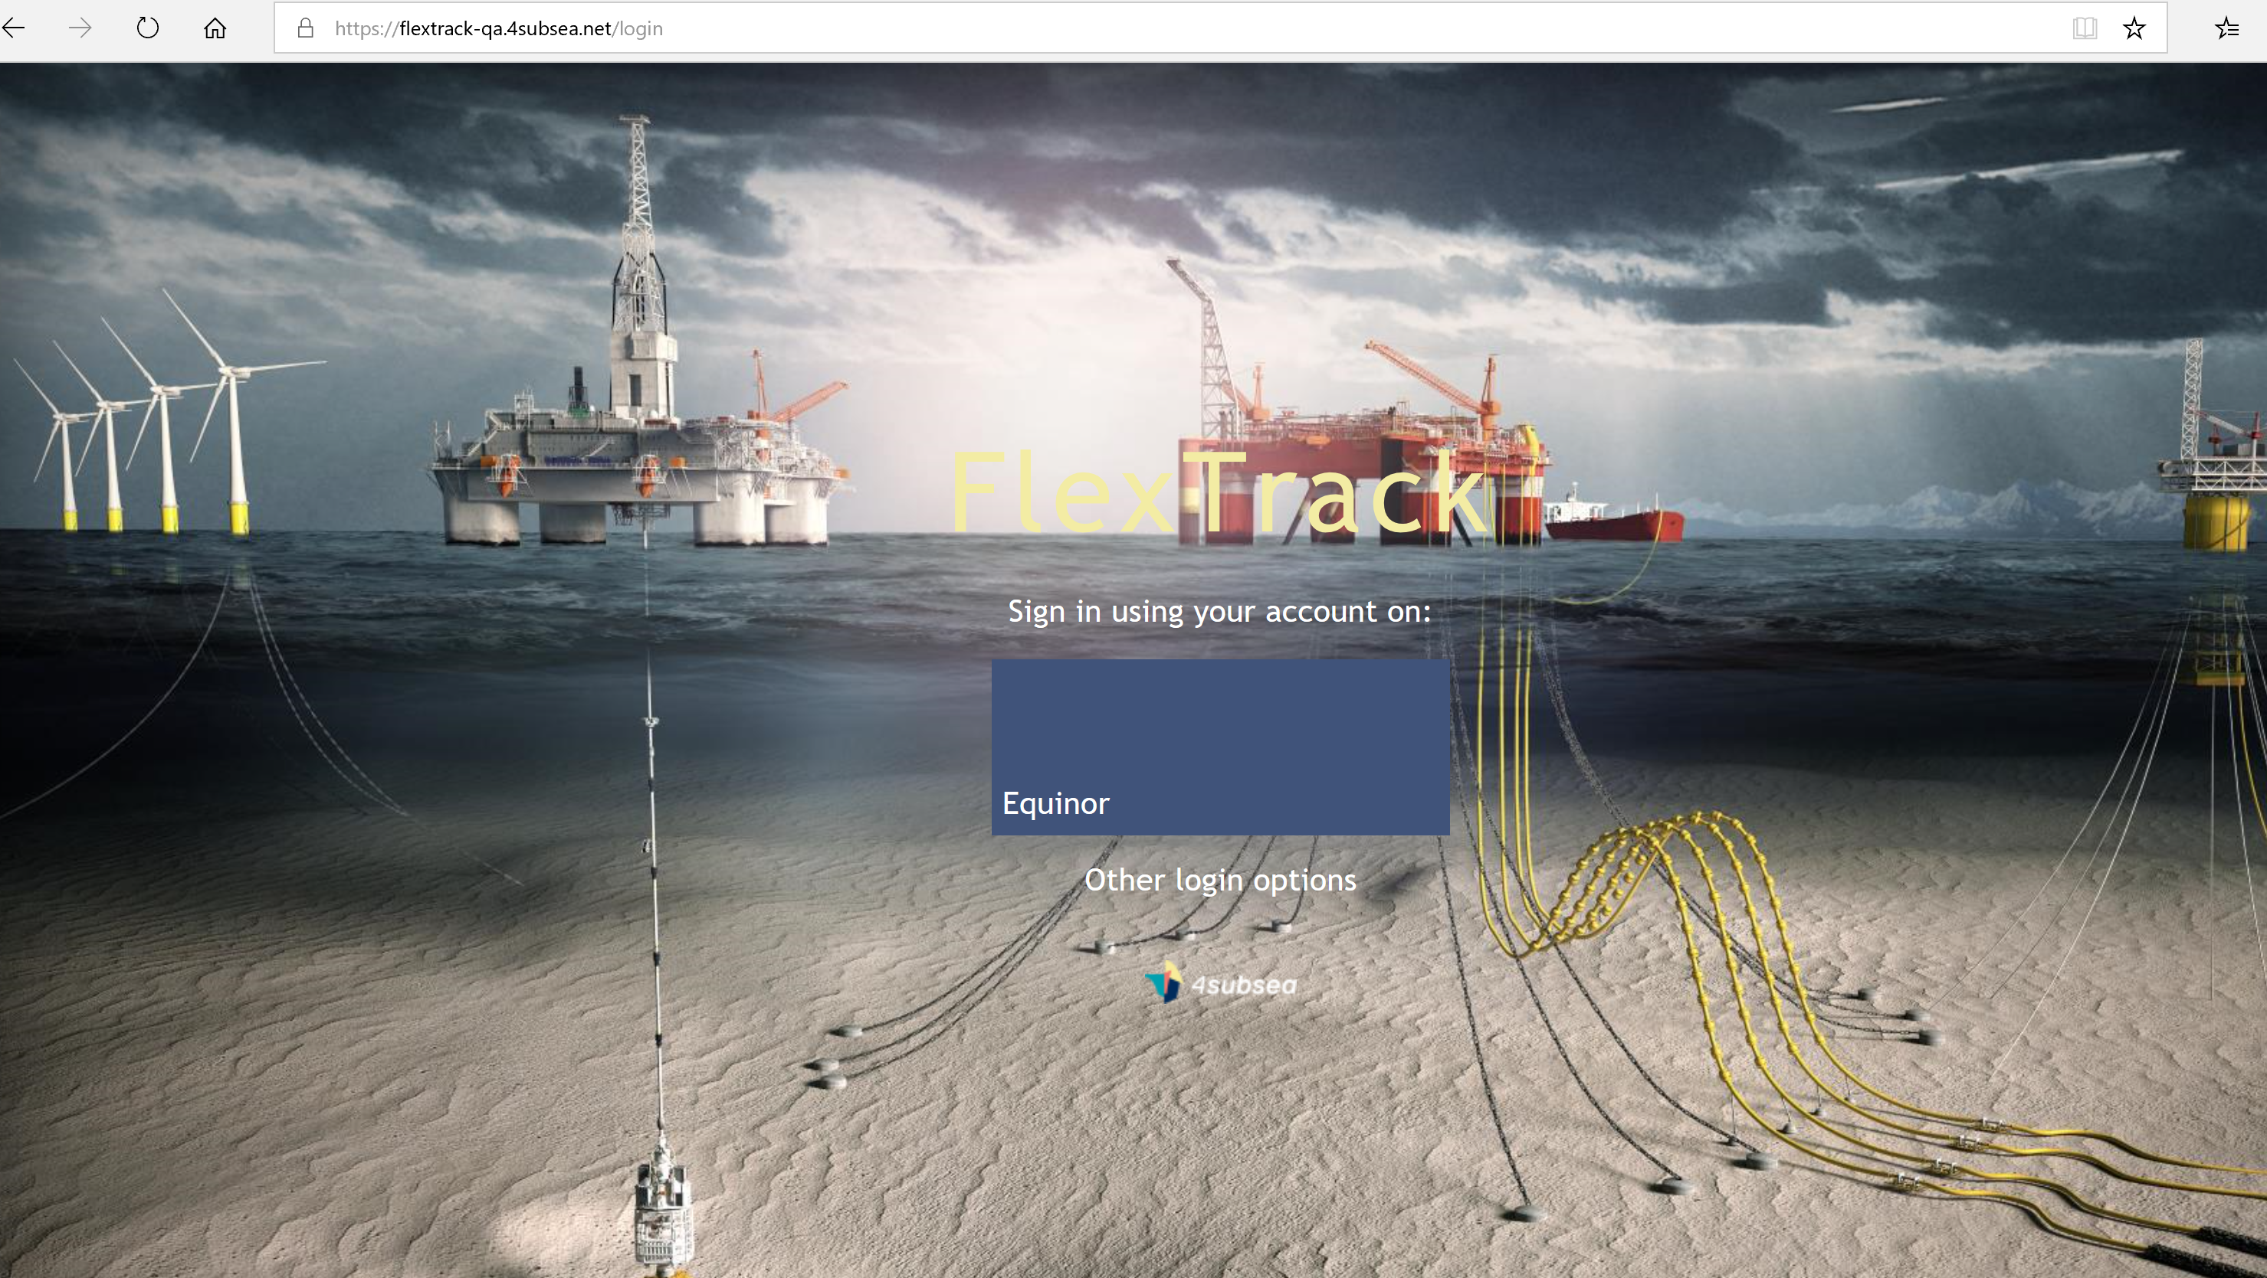
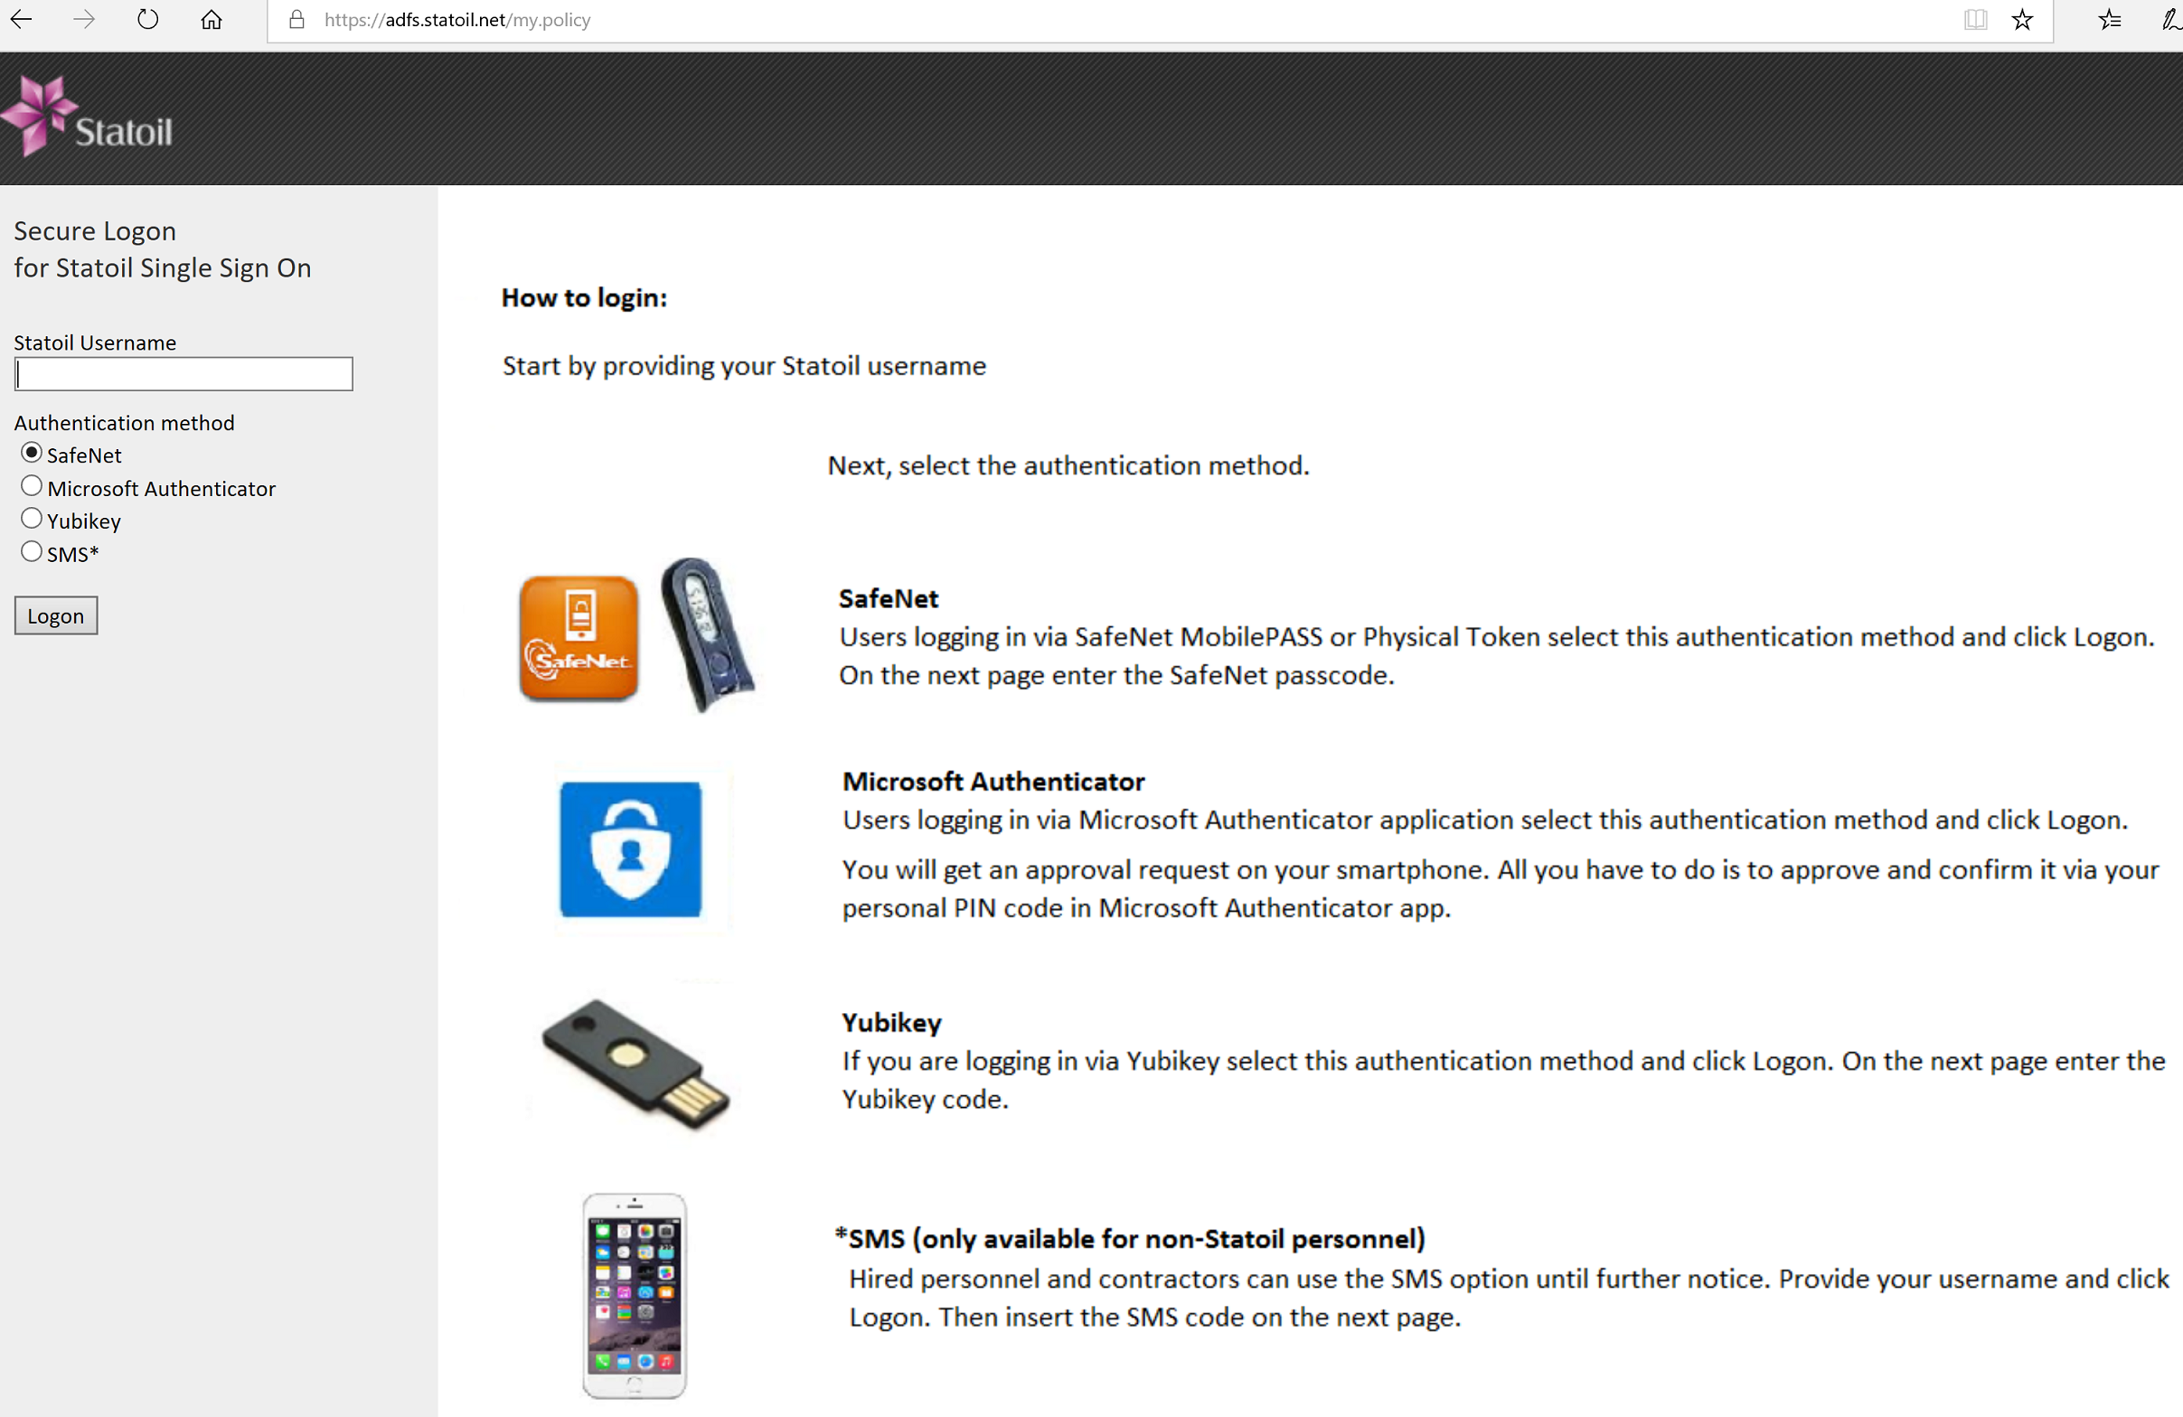
Role Playing the Threat Actor
Cloud WellSpot Application under PASTA’s Threat Analysis IV
Equinor (formerly Statoil) Example for Wellhead Operations Application
Selecting a Cloud Target in Wellhead Operations
Targeted OSINT
FlexTrack Multi-Tenant Energy App
Authentication Components
Threat Library
Sabotage
Steal
Attack Surface
Azure AD
Auth Panel
Attack Patterns
Auth Bypass
Social Eng
Vulnerable Assets
Extortion
Web API
Injection
Web Server
Web App
Human
Notes:
This slide is intended to identify possible targets to a sample Cloud based application’s threat library (previously defined). With very little OSINT, we know the following application components to WellSpot – a cloud based application managing wellhead operational data.

Slide 15

















Sample Threat Model w/ Custom Oil & Gas Threat Library
Equinor’s WellSpot Threat Model Summary Card
Author name her
Tony UcedaVelez // @t0nyuv
Threat Library
Threat Motives
Establish Persistence
Steal Secrets
Taint Data
Sabotage
Extortion
Cryptojacking
Tenant Hopping
Cloud Admin Access
Long term, multi-faceted compromise
Steal R&D Data, Wellhead locations, Well Performance Metrics
Affect accuracy in reporting for more macro economic or competitive reasons
Vengeance driven, corporate sabotage to largely disrupt availability of information, services
Hold hostage parts or complete IT infrastructure for the purposes of using as financial leverage.
Leverage compromised IT infrastructure in order to mine crypto currencies
Discover other Energy providers leveraging WellSpot multi-tenant cloud application
Obtain administrative access to control panel for aforementioned motives; sell access on black market.
Attack Surface
Attack Patterns
Associated Threats
Employees/ Contractors
Endpoints
Web Apps/ APIs
Internal Applications
Domain Controllers
Cloud Admin Panel/ API
O365
Network
Vishing, Smishing, Rogue SW
Drive-by-download, malware via docs, email
Injection based attacks, authentication by-pass
Insider threats, rogue software
Pass the hash cracking attempts
Social Eng, Illicit Cloud Access via Auth Attacks
Targeted phishing over email vector
Network MITM

Slide 16
Attack Tree Rooted by Sabotage Threat
Cloud WellSpot Application under PASTA’s Threat Analysis IV
Tony UcedaVelez // @t0nyuv
Attack trees provide DevSecOps automation blueprint
Oil & Gas depends on depends on accurate field data quickly; Cloud provides automation opportunity
Cyber related threats aim to incapacitate interconnected systems.
  Taint Data [Integrity, Availability] Research Exploration, Operations Data
  Extortion via suppressing [Availability] of Cloud management panels or Cloud Energy SaaS Apps
  Mine Cryptocurrency on PaaS infrastructure [Integrity]
  Steal Secrets (e.g. - Exploration/ R&D) [Confidentiality]

Slide 17
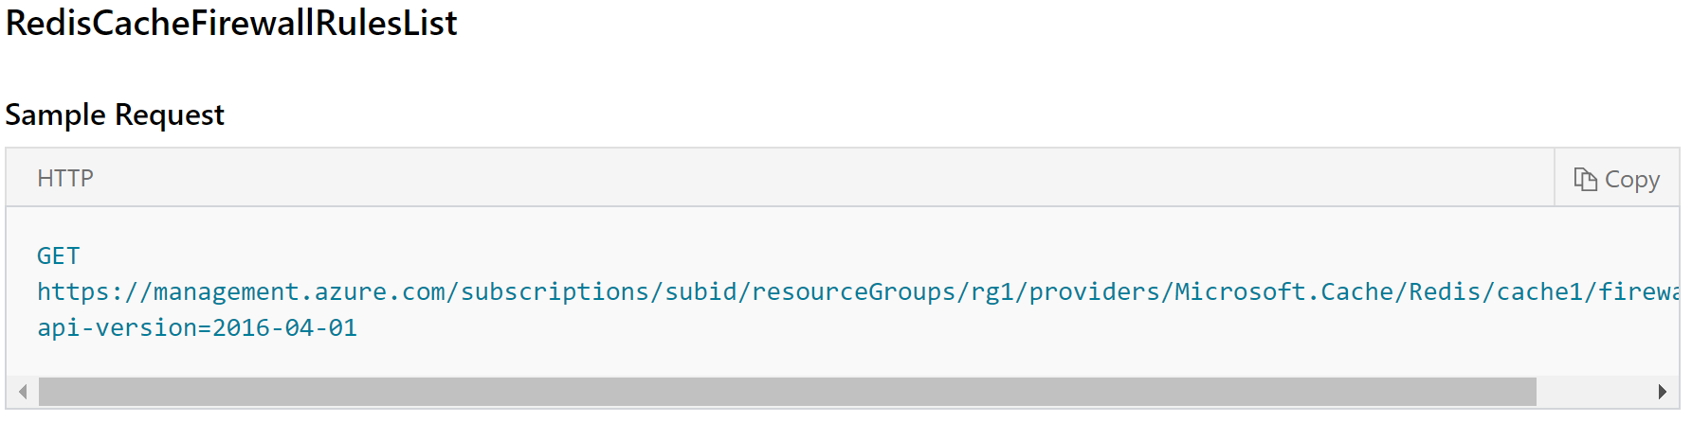
Script Mapping Countermeasures to Threat Targets
Detective Control Checks to Automate for Exposed Redis
Author name her
Tony UcedaVelez // @t0nyuv
Mapping a Detective Control to a Threat Target
Detective control can be implemented during the DevSecOps environment Build process or Deploy, Operate, & Maintain cycles
Check validates FW rules in front of Redis Cache service for Cloud Energy application.
Again, target asset or component is supported by threat model, thereby rationalizing its prioritization as a control check

Slide 18
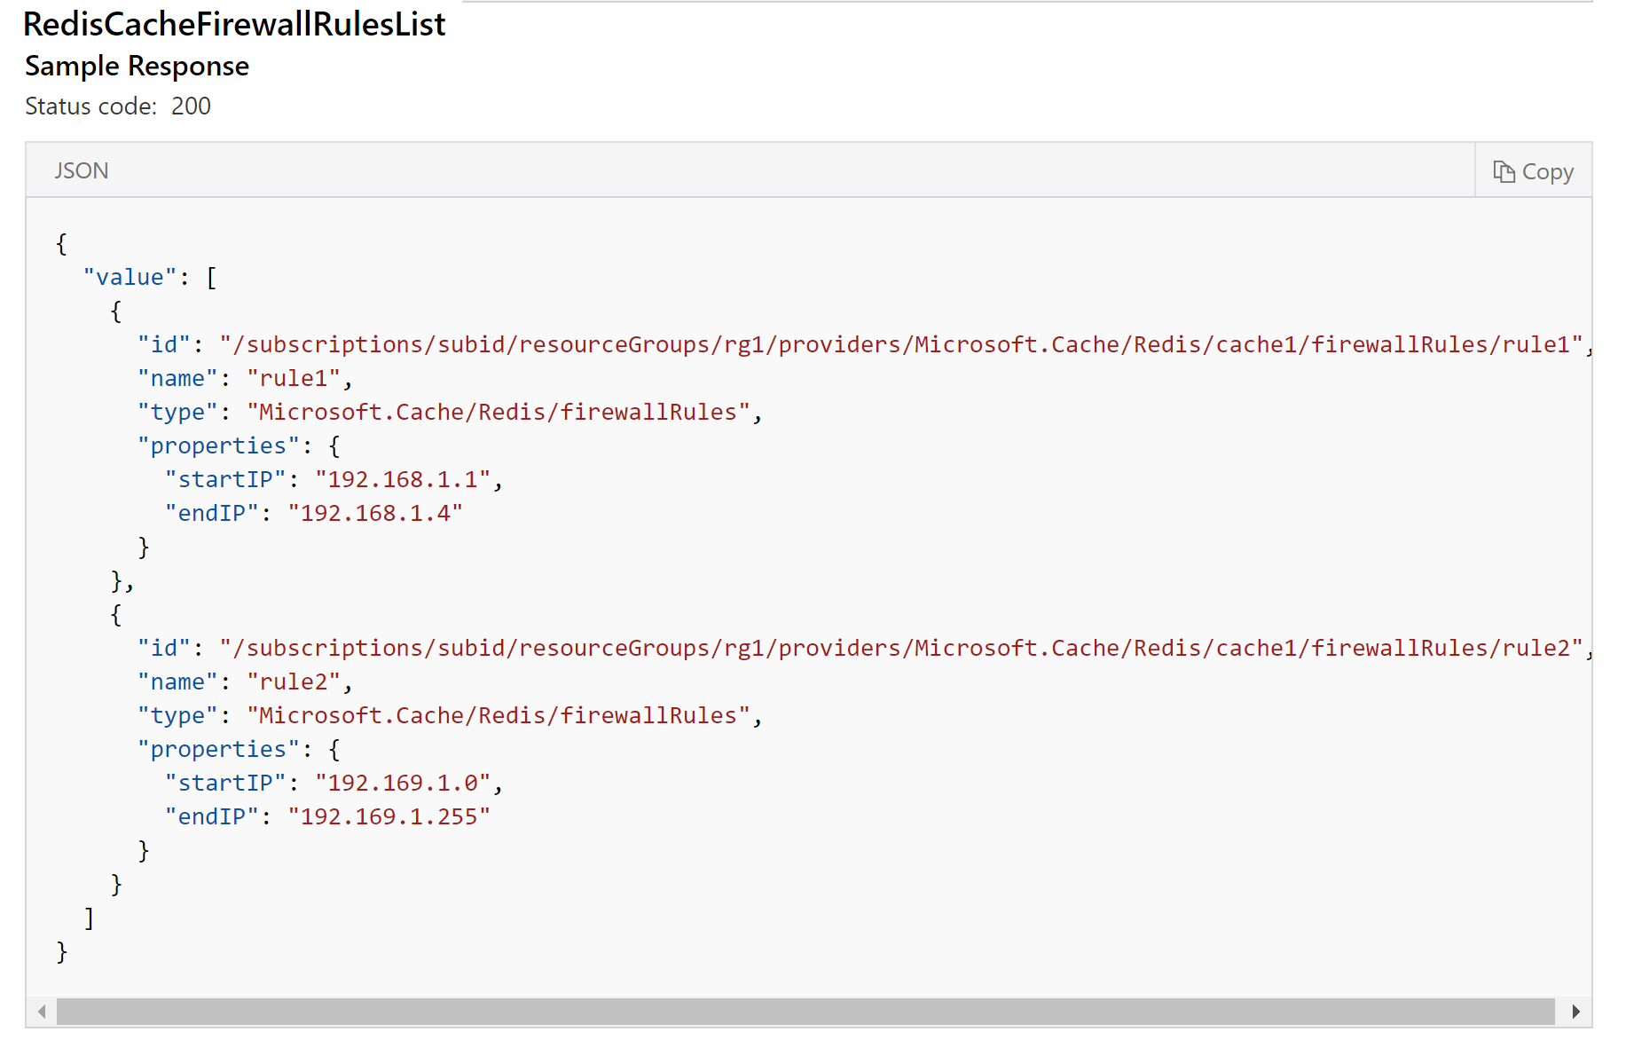
Script Mapping Countermeasures to Threat Targets
Detective Control Checks to Automate for Exposed Redis (continued)
Author name her
Tony UcedaVelez // @t0nyuv
Result Tracking on API Responses
Detective checks help to establish a baseline of security configuration under Monitor & Operate DevSecOps phases.
Detective Open Source tools like:
  Scout2 (https://github.com/nccgroup/Scout2),
  Prowler https://github.com/toniblyx/prowler)
  Cloud Security Suite https://github.com/SecurityFTW/cs-suite

Slide 19
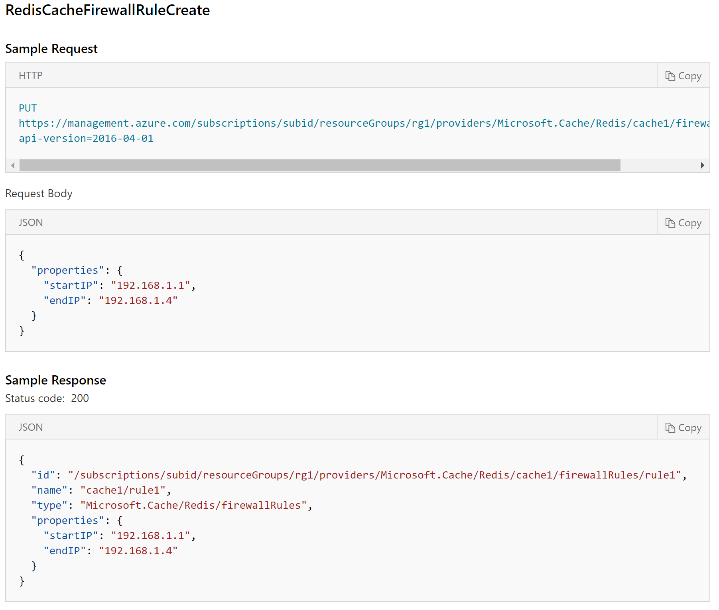
Script Mapping Countermeasures to Threat Targets
Preventative Control Checks to Automate for Exposed Redis
Author name her
Tony UcedaVelez // @t0nyuv
Result Tracking on API Responses
Detective checks help to establish a baseline of security configuration under Monitor & Operate DevSecOps phases.
Altering or creating a new rule is also easy by simply changing http method
PUT https://management.azure.com/subscriptions/{subscriptionId}/resourceGroups/{resourceGroupName}/providers/Microsoft.Cache/Redis/{cacheName}/firewallRules/{ruleName}?api-version=2016-04-01
Creating new rule can be done as part of Build or Deploy phases.

Slide 20
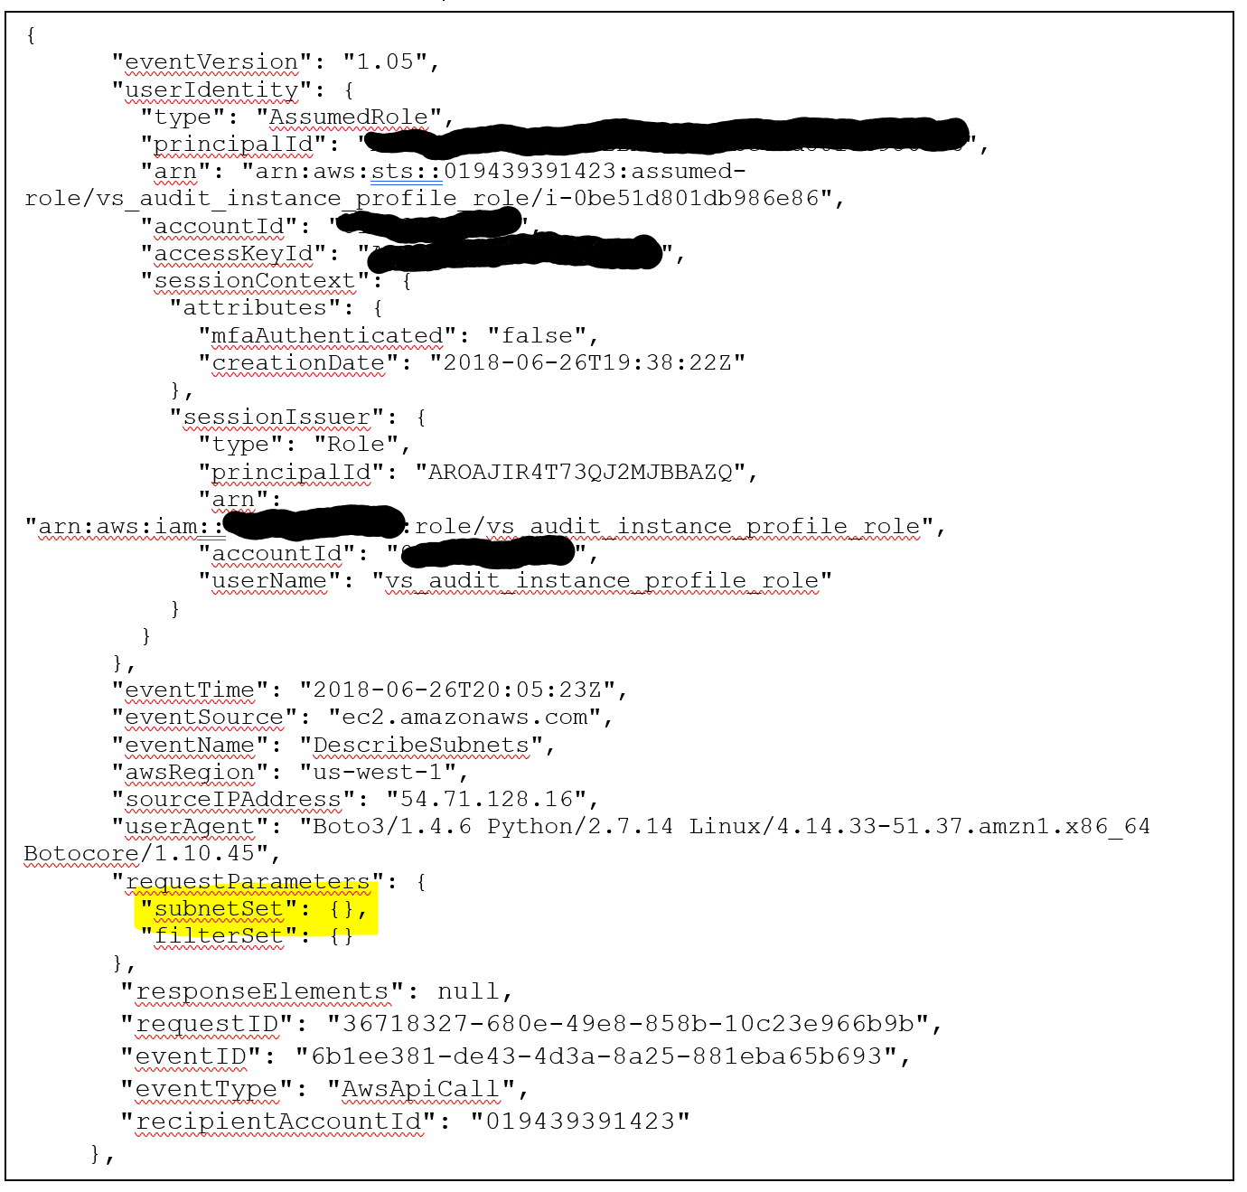
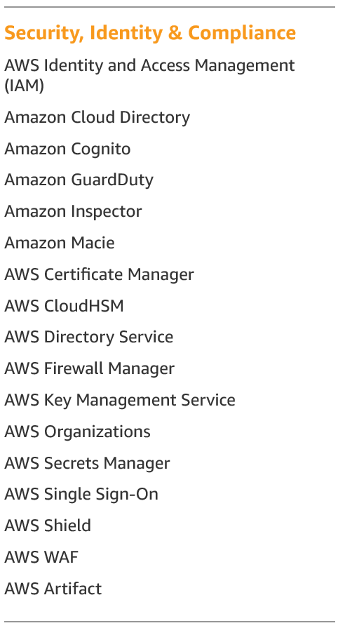
AWS Automation Opportunities
JSON Supported Web Interfaces Facilitates Security Checks
Author name her
Tony UcedaVelez // @t0nyuv
Detective controls against CloudTrail web API allows for detective audit checks.
Image on far left identifies if subnetting is present within a VPC for an AWS account. Useful for determining if subnetting perhaps needs to be present with logical ACLs applied.

Slide 21
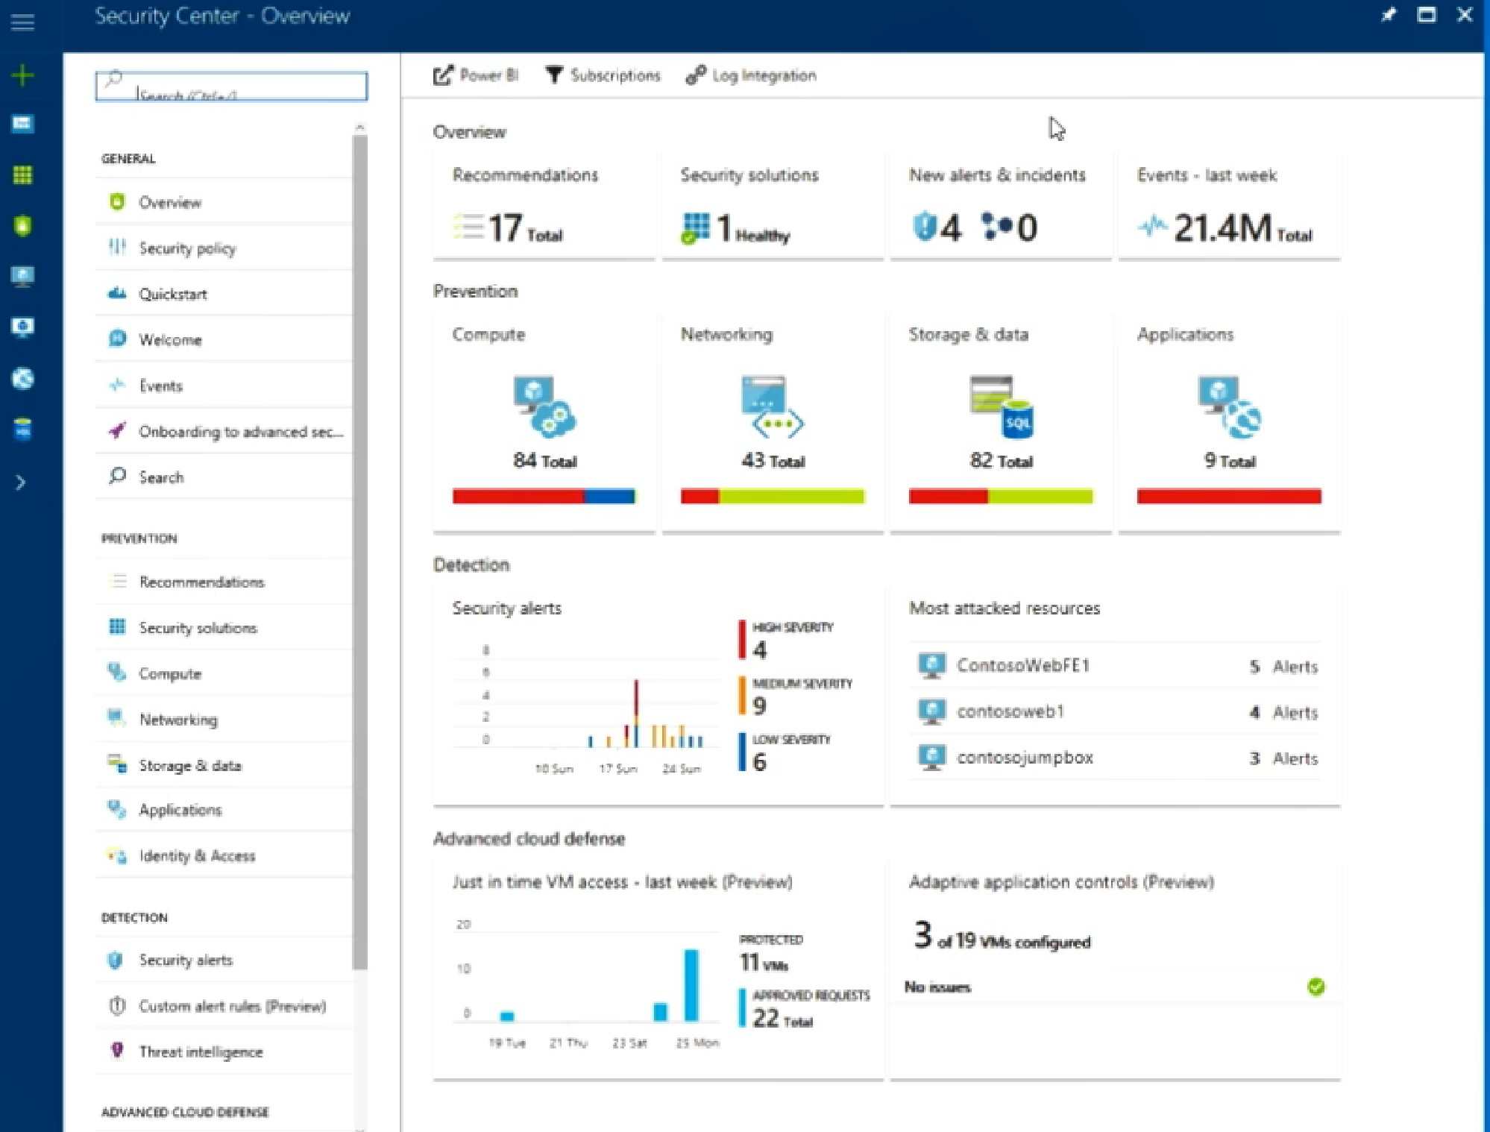
Azure Security Manager (Hybrid)
Comparing & Integrating CloudSec Ops to TM Led DevSecOps
Author name her
Tony UcedaVelez // @t0nyuv
Focused vs. Traditional
Azure provides centralized security information via Hybrid compared to 7 different AWS security product subscriptions
4SubSea management of WellSpot in Azure, following a traditional approach will be largely vuln, event driven
  Blind to a threat library or model
  Not fueling threat data back into a threat model
  Traditional approach would still be overwhelming to automate – where do you start?
Cloud security dashboards today are simply carrying traditional SOC data
  Although Azure does great job of aggregating:
    WAF Alerts
    Policy violations
    VM vulnerabilities via partner scans or Azure agents (configuration checks)
  Threat context is still missing
For Energy sector, is your SaaS provider doing either – traditional security driven or evidence, threat model supported SaaS management?
Threat inspired management of Cloud events is more focused & iterative.
*Azure Hybrid is per tenant
Notes:
Security events and alerts help provide valuable threat data.
Problem is there is too much of it.
Threat library supported threat model allows for correlated attack patterns and

Slide 22
The Future of Your Threat Lib & Security Automation
Industry Perspective + Adversarial Tendencies
“Understanding a range of threat scenarios provides the basis for security readiness and opportunity for security automation.”

Slide 23


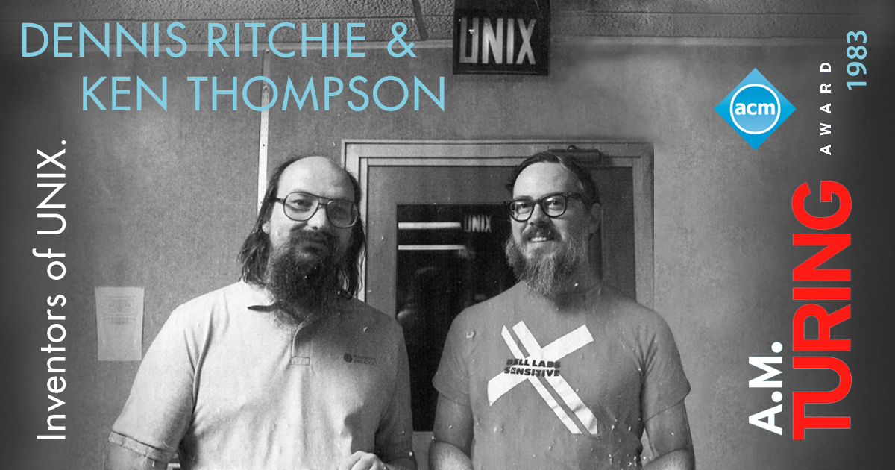
Mindset to Build Future Threat Libs
Tony UcedaVelez // @t0nyuv
Business + Hacker + Technologist = Good Threat Lib
Global Economic / Business
Hacker
Sound Technologists
Business perspective keeps understanding in terms of what are ultimately business threats, not necessarily security threats.
Hacker or criminal mindset is helpful in emulating the psych needed to circumvent barriers for the purposes of achieving threat objectives to a criminal or criminal group.
Attack patterns, vulns, and countermeasures will largely be technical. Knowing how they work and how to automate places an important role.

Slide 24
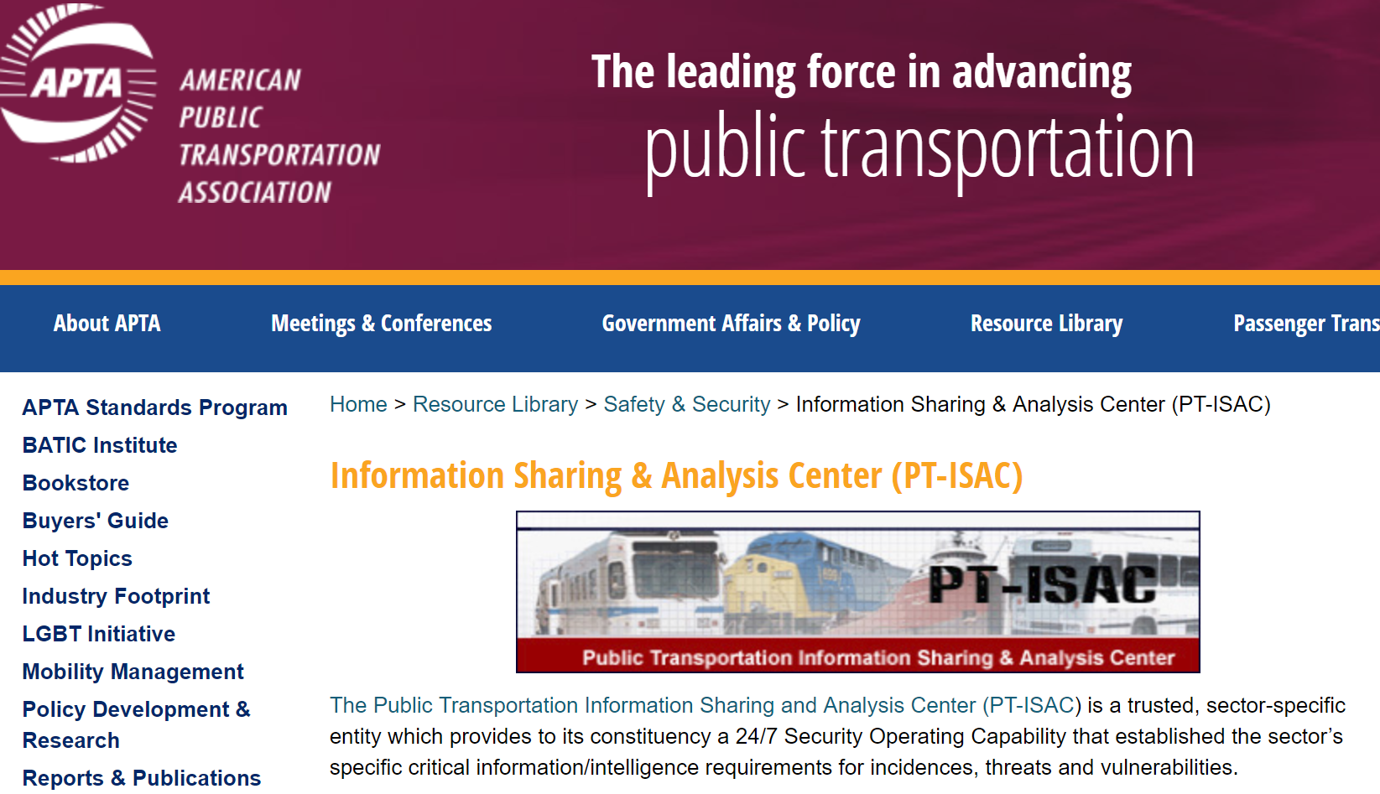

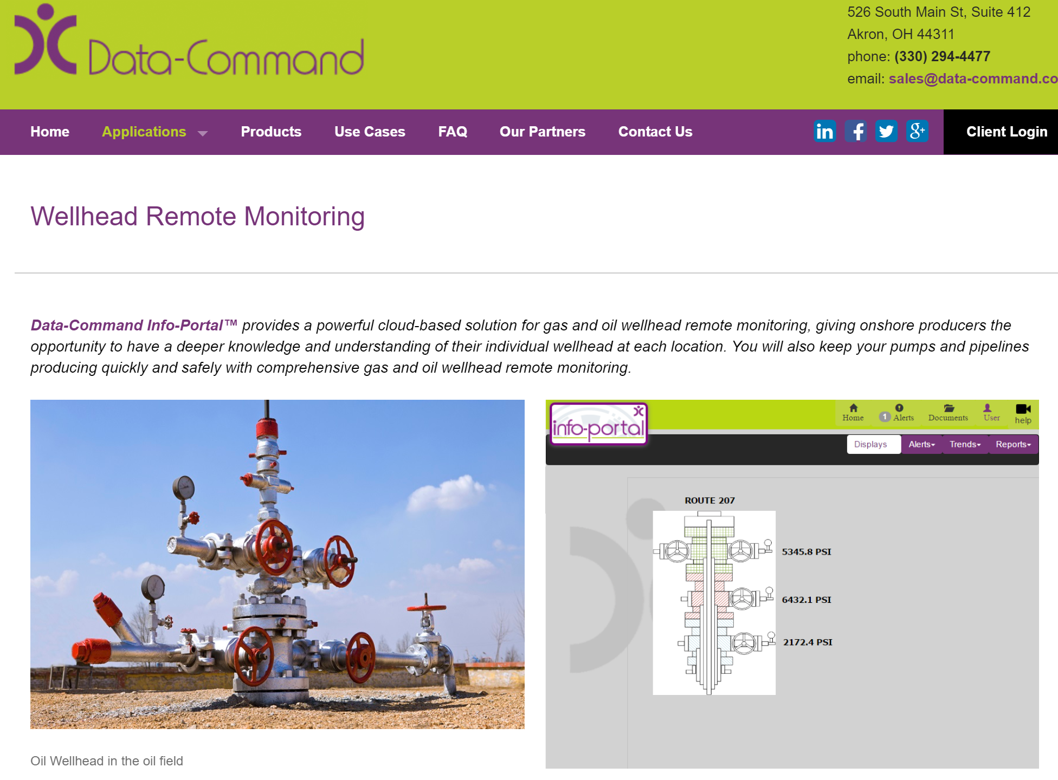
Resources & References
Grading Online Threat Information Sources
Author name her
Tony UcedaVelez // @t0nyuv
Threat Libraries Are Simple, Useful, Informative
PT-ISAC :: Transportation (U.S) C-
  TRIAD is the Transit & Rail Intelligence Awareness Daily replaces daily PT-ISAC reports. Email based.
  ISACs in general reflect prior incident information with limited IOC data. (except: FS-ISAC)
European Commission on Energy Sector A+
  CybSec in Energy Sector https://ec.europa.eu/energy/sites/ener/files/documents/eecsp_report_final.pdf
  DOE (U.S) Assessment of Electricity Disruption Incident Response Capabilities https://www.energy.gov/sites/prod/files/2018/05/f51/EO13800%20electricity%20subsector%20report.pdf B+
Twitter, Google News Alerts A-
Industry Leaders (GE), Data Command, & OEM leaders and their sector reports on data reliance for operations A+

Slide 25
Closing Remarks & Future Outlook
Threat Libs Contextualizing Security Info & Automation
Author name her
Tony UcedaVelez // @t0nyuv
Standardization, Correlation key to Automation in Cloud
“Cloud” encompass management PaaS/ IaaS layer that has exposed APIs and web UI interface
“Cloud” also encompasses the full tech stack within your SaaS. Agent or traditional agentless scans from within the Cloud remain.
Left Sided Security opportunities begin w/ a Threat inspired Threat Model → helps define security objectives in PLAN, CODE, & BUILD efforts
External threat intelligence feeds are noisy. TAXII services still need to evolve and follow a schema that can easily map CAPEC, CVEs, CWEs
Threat to Countermeasure to Threat Re-Learning automation will come from the private sector.
  Lessons from SCAP shortcomings in mass adoption
  STIX, TAXII MITRE divestiture; OASIS schema changes
Web supported interfaces facilitate greater automation via workflows
Source: metalop.com

Slide 26
Thank You
Author name her
Tony UcedaVelez // @t0nyuv
Questions?
@t0nyuv
www.linkedin.com/tonyuv
tonyuv@versprite.com
https://versprite.com/security-resources/blog/

